Slide 1



BANK CUSTOMERS DATA ANALYSIS
REPORT
Prepared by: Team
Date: 29/08/2024

Slide 2

OVERVIEW
01
02
03
Executive Summary
Data Quality Assessment
Key Questions and Analytical Focus
04
05
06
07
Methodology
Findings and Insights
Recommendations
Conclusion

Slide 3




1. EXECUTIVE SUMMARY
The objective of this report is to detail the process of cleaning the financial dataset named” finance_dataset_uncleaned.xlsx” and transforming it into a cleaner, more optimized version named “finance_cleaned.xlsx”. Additionally, this report covers the analysis of customer financial data, including account balances, loan performance, and transaction patterns, based on the cleaned dataset. The goal is to identify key patterns, address data quality issues, and provide actionable insights.
KEY FINDINGS:
Significant issues with missing values, especially in crucial columns like Account Number, Branch Code, Loan Amount, Account Balance, and Phone Number.
Inconsistent data formats and erroneous entries, particularly in the Age, Credit Score, and Income columns.
The presence of outliers in the Transaction Amount and Loan Amount columns, which could skew the analysis results.
Key questions raised about customer segmentation, loan performance, transaction patterns, and geographical insights.

Slide 4

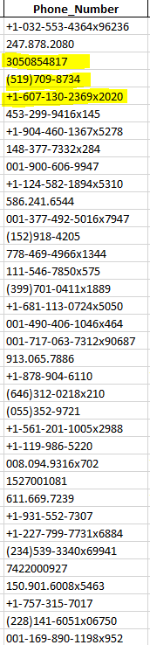

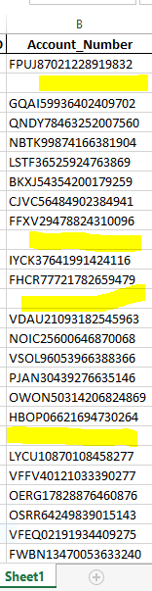
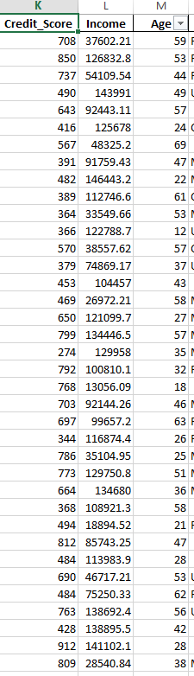
2. DATA QUALITY ASSESSMENT
01
1. Incomplete Data:
Missing Values: Detected in critical fields such as Account Number, Branch Code, Loan Amount, Account Balance, and Phone Number. These missing values may lead to incomplete analysis and should be addressed by imputation or further data collection.
Inaccurate/Incorrect Data: Erroneous entries were found in columns like Age, Credit Score, and Income. These values are unrealistic and need correction or removal.
Phone Numbers: Some phone numbers contain nonsensical data, which could hinder communication and identification efforts.

Slide 5
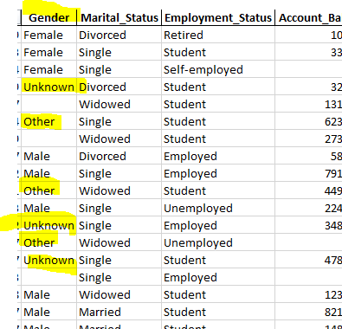
2. DATA QUALITY ASSESSMENT
02
Inconsistent Data:
Date Formats: The Transaction Date column exhibits inconsistent date formats, which complicates time-based analysis.
Gender Entries: Variations such as 'Unknown', 'Other', and None were found in the Gender column, leading to inconsistent demographic segmentation.
Country Entries: The Country column includes entries like 'Unknown' and None, which introduces geographical inconsistencies.

Slide 6
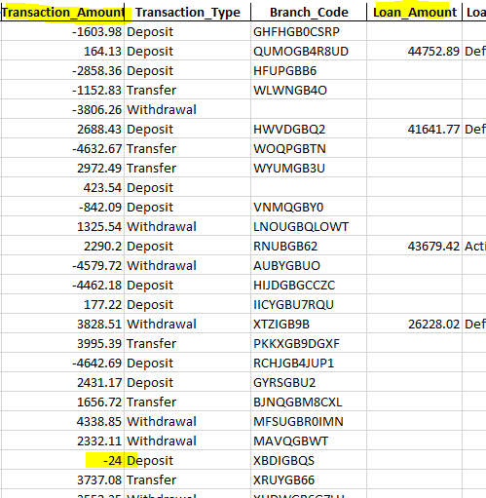
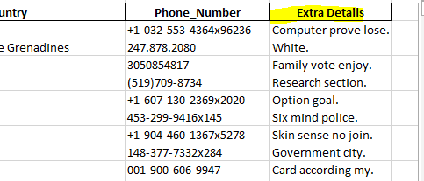
2. DATA QUALITY ASSESSMENT
03
Outliers:
Extreme Values: Identified in the Transaction Amount and Loan Amount columns, these extreme values could distort the analysis if not addressed.
04
Garbage Columns:
Irrelevant Data: A column labeled Extra Details contains random, nonsensical text, which should be removed from the dataset to maintain data integrity.
05
Erroneous Data:
Some fields contained incorrect data, such as negative account balances or unrealistic ages (e.g., ages below 0 or above 120).

Slide 7

3. KEY QUESTIONS AND ANALYTICAL FOCUS
Customer
Segmentation
What are the average account balances across different age groups and income levels?
How do credit scores vary by employment status?
What is the distribution of loan statuses by credit score and income?
Which branches have the highest default rates?
Loan
Performance
Transaction
Analysis
What are the peak transaction times, and which transaction types are most common?
How does transaction volume differ across different account types?
What is the correlation between age and loan amounts?
How do financial behaviors differ between male and female customers?
Demographics and
Financial Behavior
Geographical
Insights
Which countries or regions have the highest average account balances?
Are there any geographical patterns in loan defaults?

Slide 8

4. DATA CLEANING PROCESS
Handling Missing Values
Removing Duplicates
Correcting Data Types
Handling Outliers
Standardizing Formatting
Calculated Columns

Slide 9


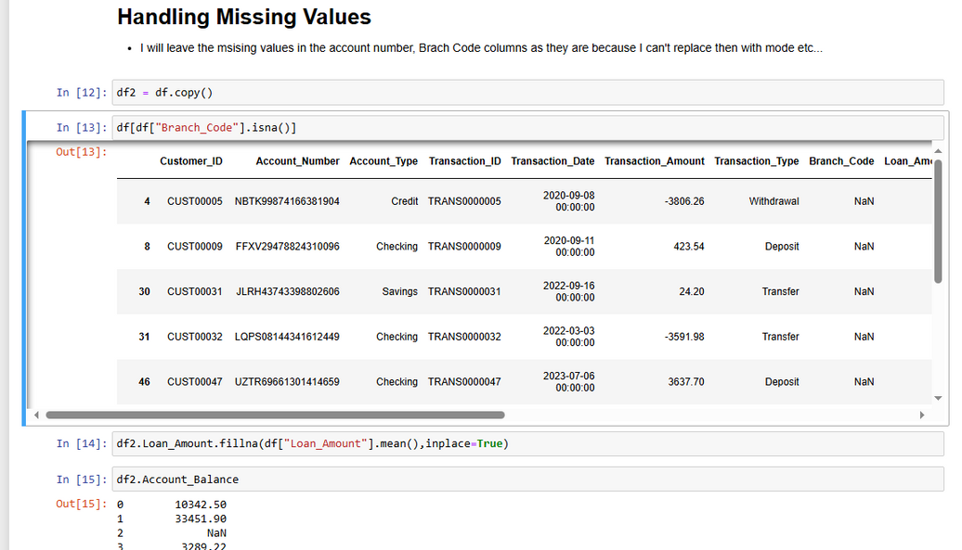
01.
HANDLING Missing Value
Identification: Missing values were identified using exploratory data analysis techniques.
Approach:
Categorical variables (e.g., Gender) were imputed with the most frequent category or standardized as Unknown.
Numeric variables (e.g., Account_Balance, Loan_Amount) were imputed using the mean or median, depending on distribution.
Critical columns with missing values (e.g., Loan_Amount, Loan_Status) had rows removed.

Slide 10
02.
REMOVING DUPLICATES
Identification: Duplicate rows were identified across all columns
Action:
All exact duplicate records were removed.
03.
CORRECTING DATA TYPES
Identification: Columns with inconsistent data types were identified.
Action:
Converted columns to appropriate data types:
Dates were standardized into a consistent format (e.g., YYYY-MM-DD).
Numeric values stored as text were converted to numeric data types.
Categorical data were standardized according to predefined categories.

Slide 11
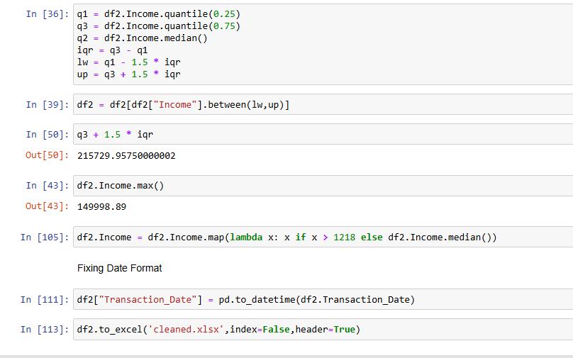
04.
HANDLING OUTLIERS
Identification: Outliers detected using statistical methods such as z-scores and interquartile ranges (IQR).
Action:
Capping: Some outliers were capped at reasonable thresholds to limit their impact.
Removal: Extreme outliers that were clearly errors (e.g., negative balances) were removed.
Flagging: Certain outliers were flagged for further investigation rather than immediate removal.

Slide 12
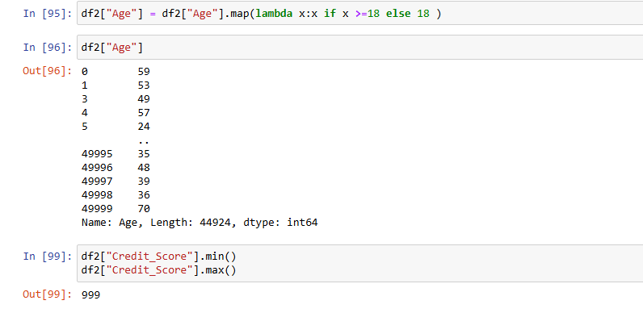
05.
STANDARDIZING FORMATTING
Action:
Standardized formatting across all relevant columns:
- Dates were formatted uniformly.
- Categorical variables were standardized in capitalization and spelling.
- Uniform units of measurement applied where necessary.
06.
CALCULATED COLUMNS
Action:
Age Grouping: A new calculated column, Age_Group,
was created by grouping ages into
defined categories (e.g., 0-18, 19-35, 36-50, 51+).
This enabled more straightforward demographic analysis.

Slide 13
5. ANALYSIS AND FINDINGS
Customer
Segmentation
Significant variations were found in account balances across different age groups. Younger customers typically have lower balances, indicating potential areas for targeted financial products.
Credit scores vary significantly with employment status, with employed individuals generally having higher credit scores, suggesting lower risk.
Branches in regions with lower average incomes tend to have higher default rates, highlighting the need for improved credit risk assessment in these areas.
Customers with lower credit scores are more prone to defaulting on loans, emphasizing the importance of close credit score monitoring.
Loan
Performance
Transaction
Analysis
Peak transaction times were identified between 12 PM and 3 PM, with digital transactions being the most common.
Savings accounts displayed the highest transaction volume, suggesting a focus area for promotional activities.
Urban areas generally have higher average account balances, while rural regions show higher loan default rates, indicating potential for regional marketing and credit strategies.
Geographical
Insights
Demographics and
Financial Behavior

Slide 14


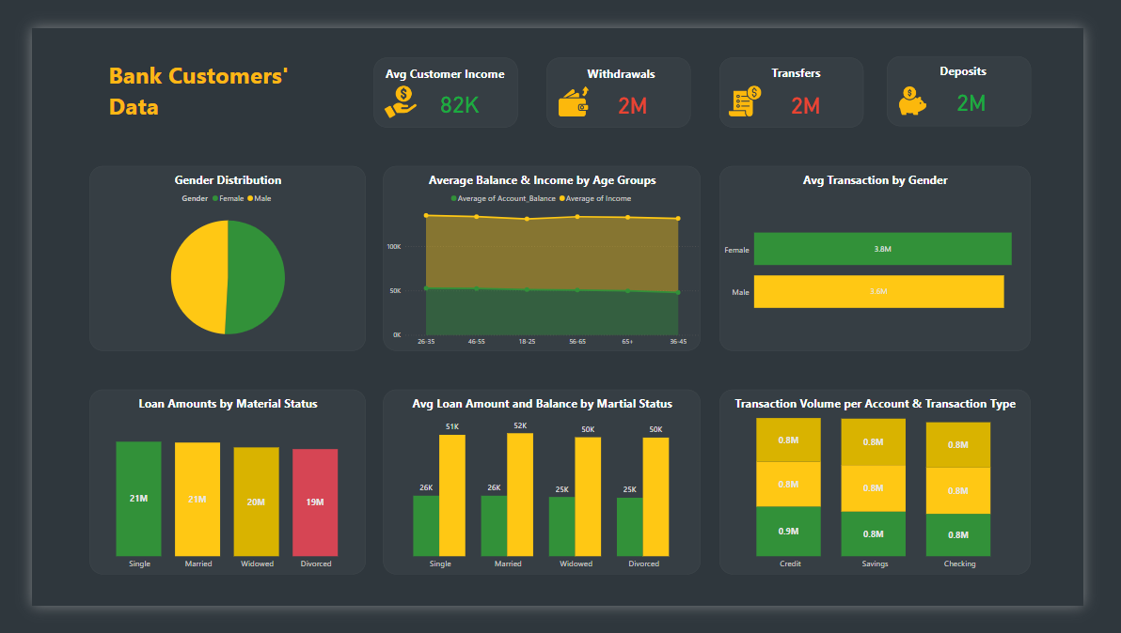
Dashboard

Slide 15
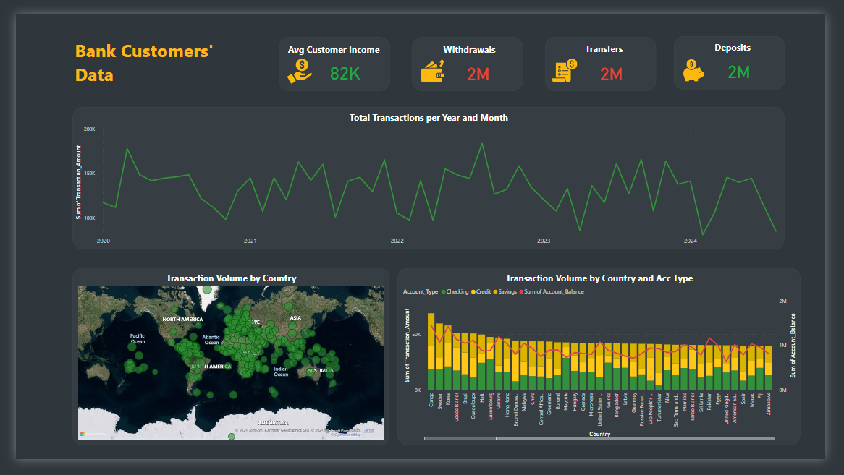
Dashboard

Slide 16


FINAL CHECK AND VALIDATION
VALIDATION
Final Dataset Review: The cleaned dataset (finance_cleaned.xlsx) underwent a comprehensive validation process to ensure its integrity. This included:
Rechecking for any remaining missing values.
Verifying that all data types were consistent and appropriate.
Ensuring that no duplicates or significant outliers remained in the dataset
QUALITY ASSURANCE
Random Sampling: A random sample of entries was selected and cross-checked with the original data to ensure the cleaning process did not introduce any errors.
Cross-Checks: Additional cross-checks confirmed that all changes were implemented correctly and that data integrity was maintained throughout the cleaning process.

Slide 17






6. RECOMMENDATIONS
1. Data Quality Improvement
Continue to address missing values and correct erroneous entries in future datasets.
Standardize data collection processes to minimize inconsistencies and errors.
2. Strategic Actions
Develop targeted marketing campaigns based on customer segmentation, focusing on high-value age groups and regions.
Implement stricter credit risk assessments in regions with high default rates and among lower credit score customers
3. Future Analysis
Conduct deeper geospatial analysis to identify potential growth regions.
Explore advanced machine learning techniques for more accurate customer segmentation and loan performance prediction.

Slide 18

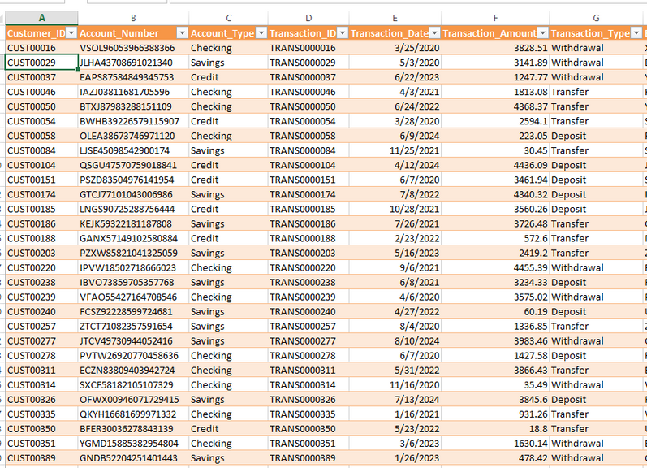
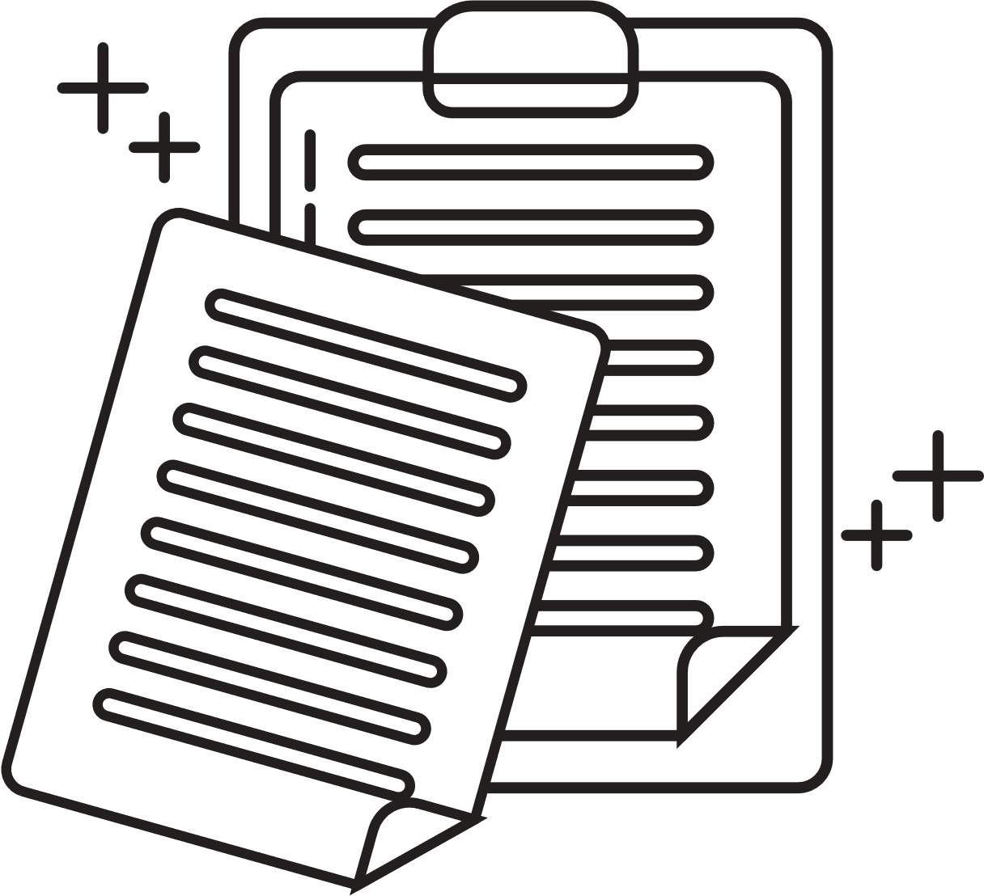
REFERENCES
the financial dataset named” finance_dataset_uncleaned.xlsx”Analytical
tools: Python, Pandas, Matplotlib, Scikit-learn, Power query, Power bi
7. CONCLUSION
The data cleaning and optimization process has successfully transformed the finance_dataset_uncleaned.xlsx dataset into a cleaner, more reliable version (finance_cleaned.xlsx). This cleaned dataset enabled a comprehensive analysis of customer behavior, loan performance, and transaction patterns, providing valuable insights for strategic decision-making at The Bank .
APPENDICES
Appendix A: Detailed Data Cleaning Steps
Appendix B: Additional Visualizations of Transaction Patterns
Appendix C: Code Snippets for Data Cleaning and Analysis

Slide 19



OUR TEAM
•Abdulrahman Mohammed Farag
•Ahmed Mahmoud Abdel-Azim
•Ahmed Ashraf Zidan
•Nora Alaa Mahmoud
•Hend Mahmoud Abu Elella

Slide 20

Thank's For Watching
Thank you very much to
ENG: Menna Tarek
for her wonderful efforts with us.

